Slide 1
HEALTH CARE MANAGEMENT
HACK SUMMIT 2019

Slide 2

HEALTH CARE MANAGEMENT
Healthcare management, is the administration, management or oversight of healthcare systems, public health systems, hospitals, entire hospital networks or other medical facilities.

Slide 3
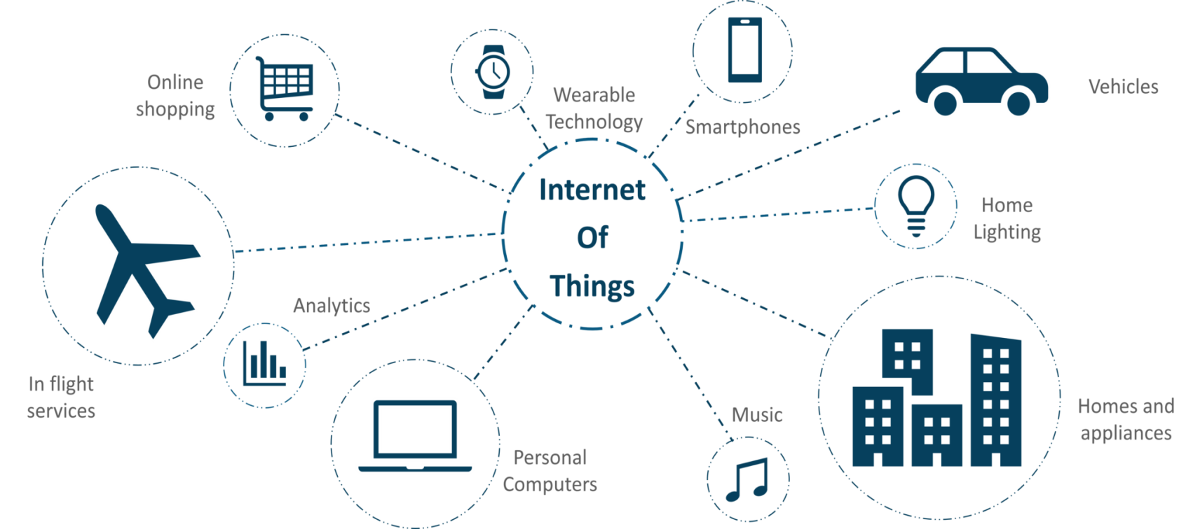
Internet of Things(IoT)
The internet of things, or IoT, is a system of interrelated computing devices, mechanical and digital machines, objects, animals or people that are provided with unique identifiers (UIDs) and the ability to transfer data over a network without requiring human-to-human or human-to-computer interaction

Slide 4
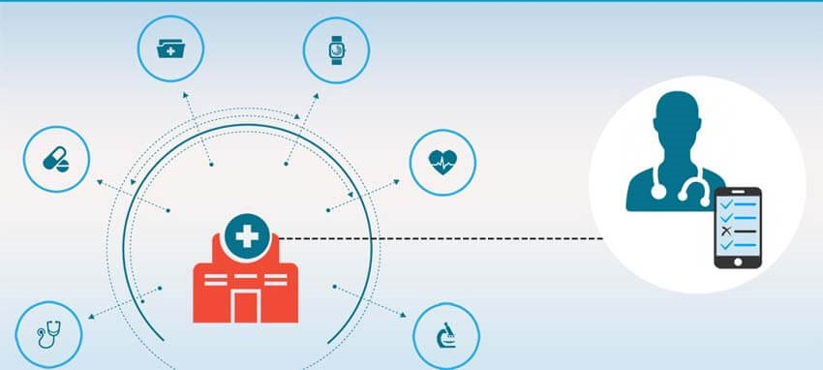
IoT in HealthCare Managament
IoT is undoubtedly transforming the healthcare industry by redefining the space of devices and people interaction in delivering healthcare solutions. IoT has applications in healthcare that benefit patients, families, physicians, hospitals and insurance companies.

Slide 5
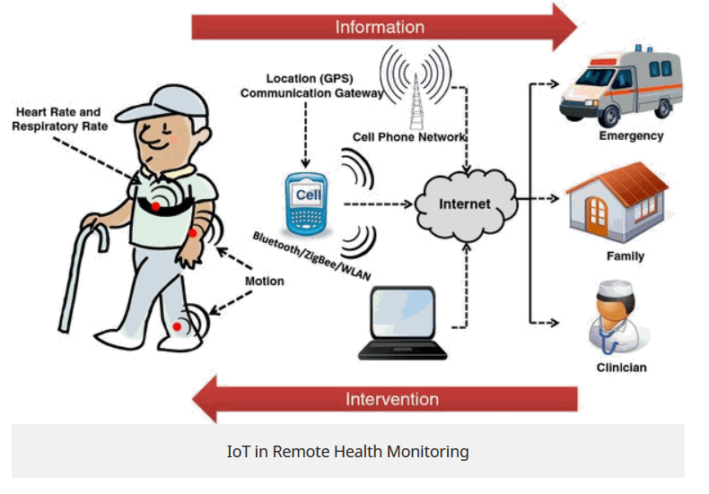
Remote Health Monitoring
Remote patient monitoring presents tremendous potential to
disrupt traditional healthcare delivery models and expand the reach of quality healthcare to the aging and remote population.

Slide 6
OUTLINE
Patient
↓
Abnormal condition
↓
Sensed by suitable sensor
↓
Signal transmitted to Arduino
↓
Arduino IDE receives signal
↓
IDE code generates SMS
↓
Care taker recieves SMS

Slide 7
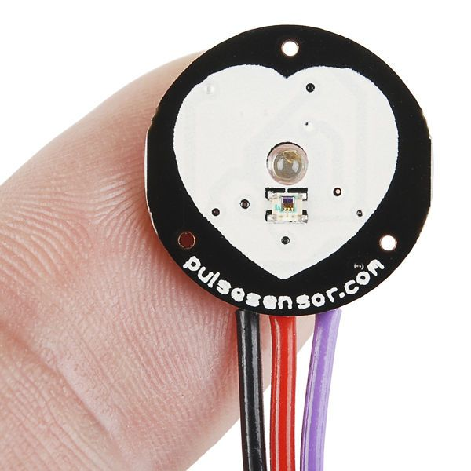
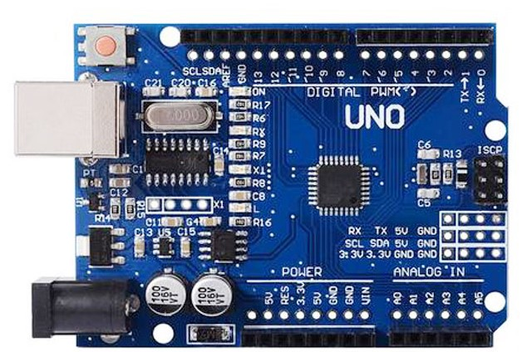
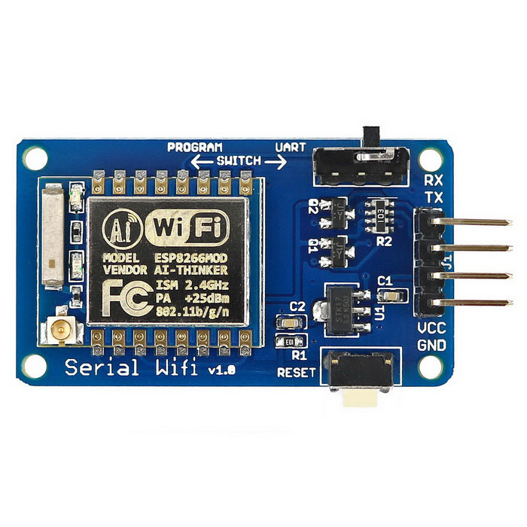
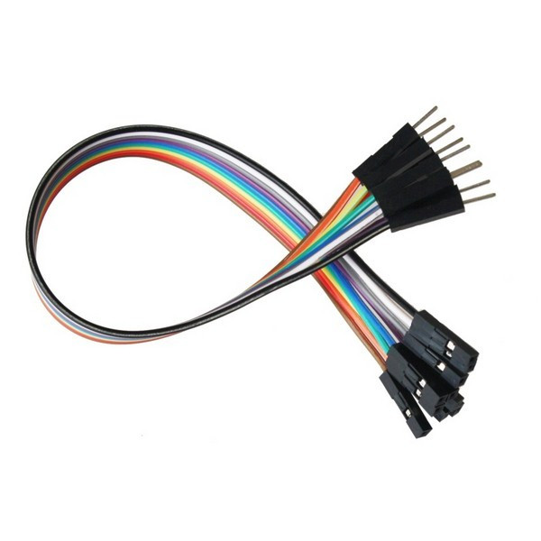
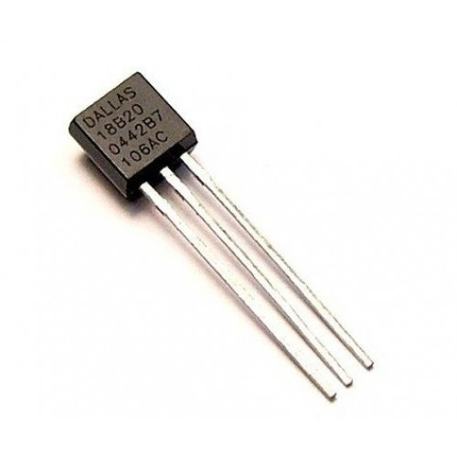
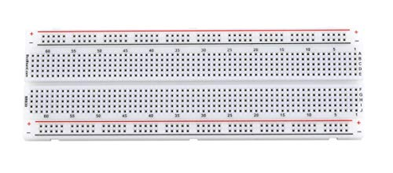
Patient Monitoring Hardware Requirements
Pulse sensor Arduino UNO ESP8266
Breadboard Temperature sensor Jumper cables

Slide 8
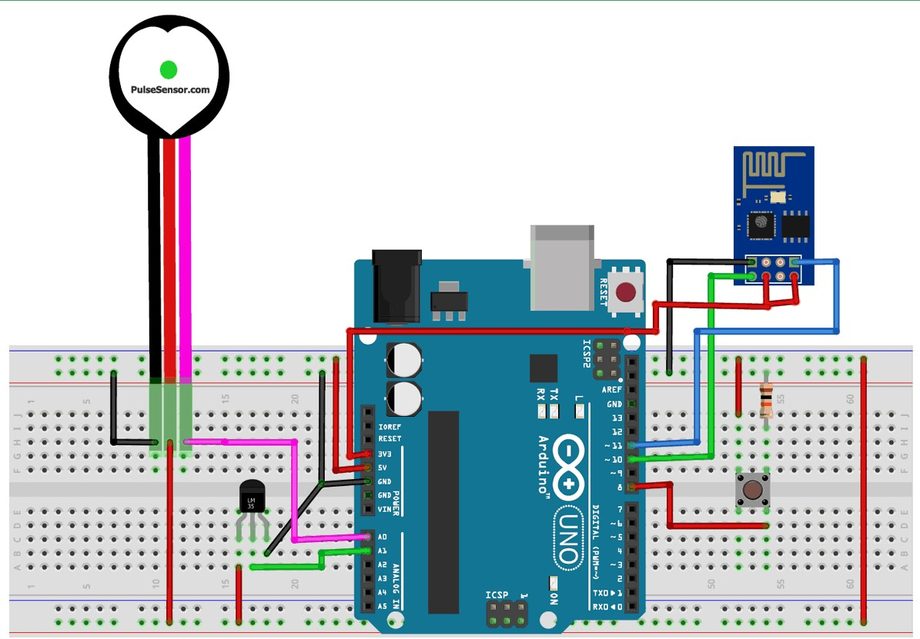
CIRCUIT DIAGRAM

Slide 9
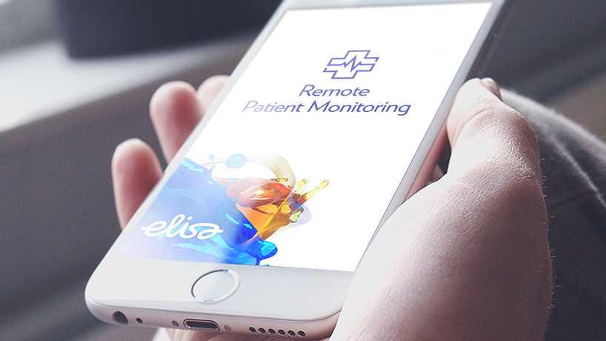
OUTPUT OF INNOVATION
“Studies have shown that a telehealth system can save every hospital system in the country 30,253.81 INR per patient. Think about that. It’s game-changing.”

Slide 10
BENEFITS OF INNOVATION
Reducing the waiting time for hospital admission
Constant remote care of specialists
Shortening response time in the event of an emergency
Improved therapy effectiveness
Safer access to own medical data

Slide 11
THANK YOU

